Slide 1
Random Number/variable generation
Xueping Li
Industrial & Systems Engineering
University of Tennessee, Knoxville

Slide 2
Let’s try to get some “random” numbers
2,4;
1,2;
1,3;
3,4;
5,7;
5,8;
1,3;
3,8

Slide 3
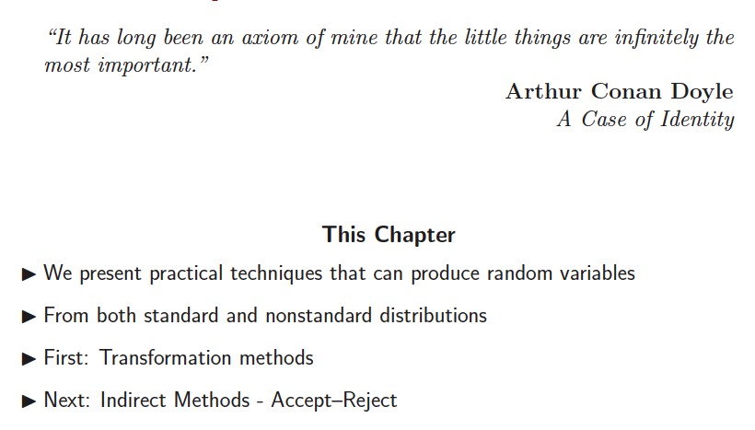

Slide 4
Monte Carlo methods
“Monte Carlo methods (or Monte Carlo experiments) are a broad class of computational algorithms that rely on repeated random sampling to obtain numerical results. They are often used in physical and mathematical problems and are most useful when it is difficult or impossible to use other mathematical methods. Monte Carlo methods are mainly used in three distinct problem classes: optimization, numerical integration, and generating draws from a probability distribution.”
Courtesy of Wikipedia

Slide 5
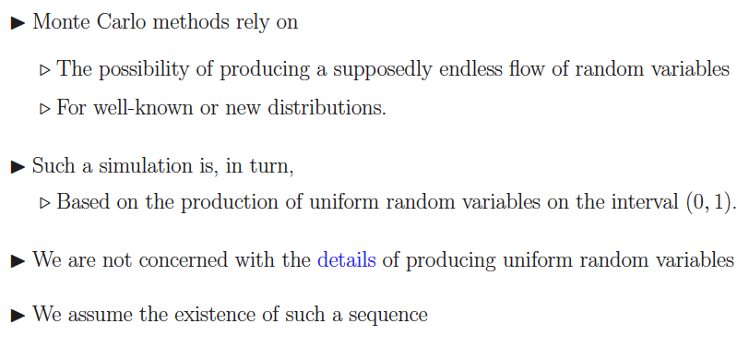

Slide 6
RNGs
Random Numbers Generators
Mid-square method
LCM (LCG)
…

Slide 7
Random Numbers
Why is random number generation necessary?
In a simulated system, there are inherently random components that require a method of obtaining numbers that are random.
For example - a queuing system model requires interarrival times, service times, etc., that were drawn from some specified distribution.

Slide 8
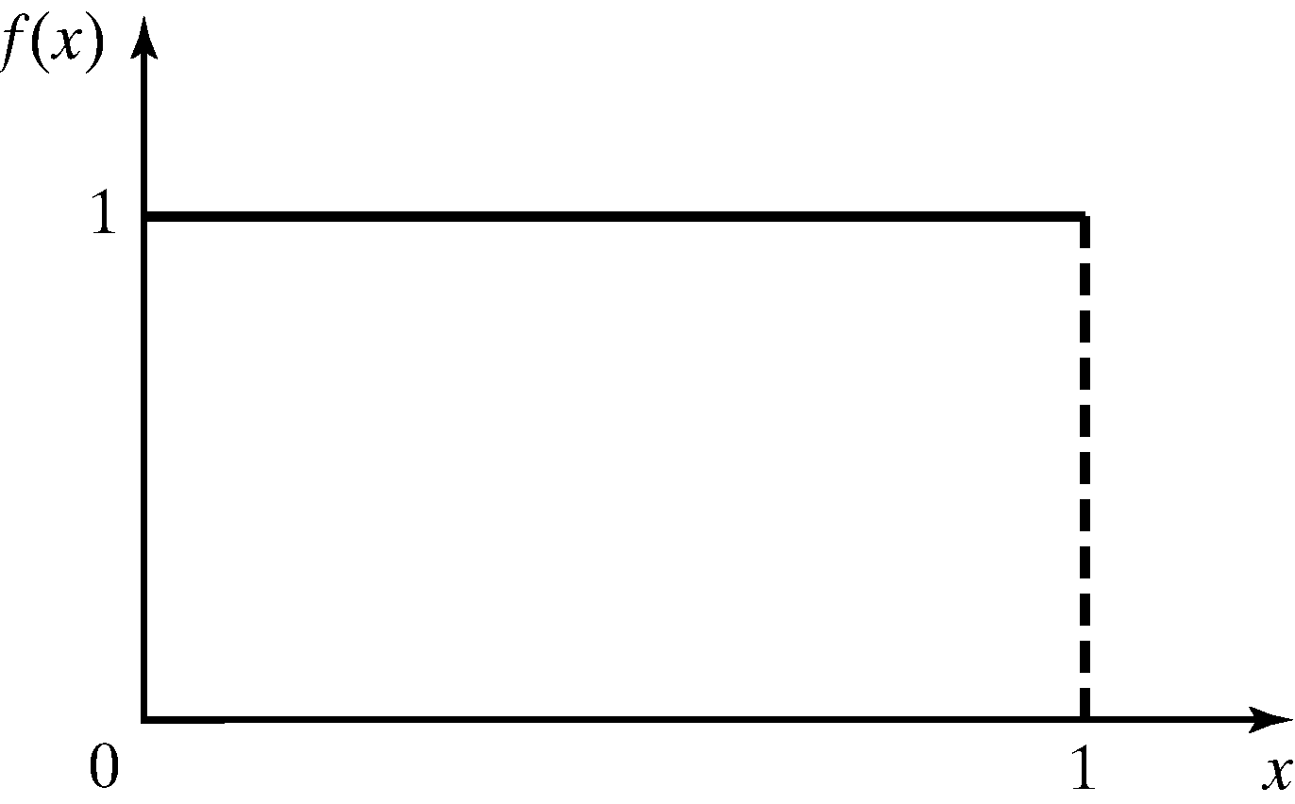
Properties of Random Numbers
Two important statistical properties:
Uniformity
Independence.
Random Number, Ri, must be independently drawn from a uniform distribution with pdf:
Figure: pdf for random numbers

Slide 9
Cont.
Independence - the probability of observing a value in a particular interval is independent of the previous value drawn.
Expected value and variance of random numbers
Expected value of each R_{i} is given by
Variance for each Ri is given by

Slide 10
Generation of Pseudo-Random Numbers
“Pseudo”, because generating numbers using a known method removes the potential for true randomness.
Goal: To produce a sequence of numbers in [0,1] that simulates, or imitates, the ideal properties of random numbers (RN).
Important considerations in RN routines:
Fast
Portable to different computers
Have sufficiently long cycle
Replicable
Closely approximate the ideal statistical properties of uniformity and independence.

Slide 11
Midsquare Generator
Random number seed - initial random number used to generate the next random number which is in turn transformed into the new seed value.
Proposed by von Neumann and Metropolis in the 1940’s
Start with an initial four-digit positive integer seed X₀
Square it to obtain an integer with up to eight digits
Take the middle four digits as the next four-digit number, X₁
Place a decimal point at the left of X₁ to get first random number R₁
Square X₁ and continue process

Slide 12
Example
Let X₀ = 5497
X₁ = (5497)² = 30217009 X₁ = 2170, R₁ = 0.2170
X₂ = (2170)² = 04708900 X₂ = 7089, R₂ = 0.7089
X₃ = (7089)² = 50253921 X₃ = 2539, R₃ = 0.2539
...and so on...
Pros of the midsquare method
Rather simple to implement
Cons of the midsquare method
Difficult to choose initial seed that will give good sequence
Strong tendency to degenerate fairly rapidly to zero

Slide 13
More examples (poor)
Let X₀ = 5197
X₁ = (5197)² = 27008809 X₁ = 0088, R₁ = 0.0088
X₂ = (0088)² = 00007744 X₂ = 0077, R₂ = 0.0077
X₃ = (0077)² = 00005929 X₃ = 0059, R₃ = 0.0059
X₄ = (0059)² = 00003481 X₄ = 0034, R₄ = 0.0034
Let X₀ = 6500
X₁ = (6500)² = 42250000 X₁ = 2500, R₁ = 0.2500
X₂ = (2500)² = 06250000 X₂ = 2500, R₂ = 0.2500

Slide 14
More examples …

Slide 15
Linear Congruential Generator
To produce a sequence of integers, X₁, X₂, … between 0 and m-1 by following a recursive relationship:
X(i+1)=(a*X(i) +C) mod m
The selection of the values for a, c, m, and X₀ drastically affects the statistical properties and the cycle length.
The random integers are being generated [0,m-1], and to convert the integers to random numbers:

Slide 16
E.g.,
Use X₀ = 27, a = 17, c = 43, and m = 100.
The X_{i} and R_{i} values are:
X₁ = (17*27+43) mod 100 = 502 mod 100 = 2, R₁ = 0.02;
X₂ = (17*2+43) mod 100 = 77, R₂ = 0.77;
X₃ = (17*77+43) mod 100 = 52, R₃ = 0.52;
…

Slide 17
Period = 2000

Slide 18
LCG:: “Good” Examples
A= 25214903917, M=2^48, C=11
A=6364136223846793005, M=2^64, C=1442695040888963407

Slide 19
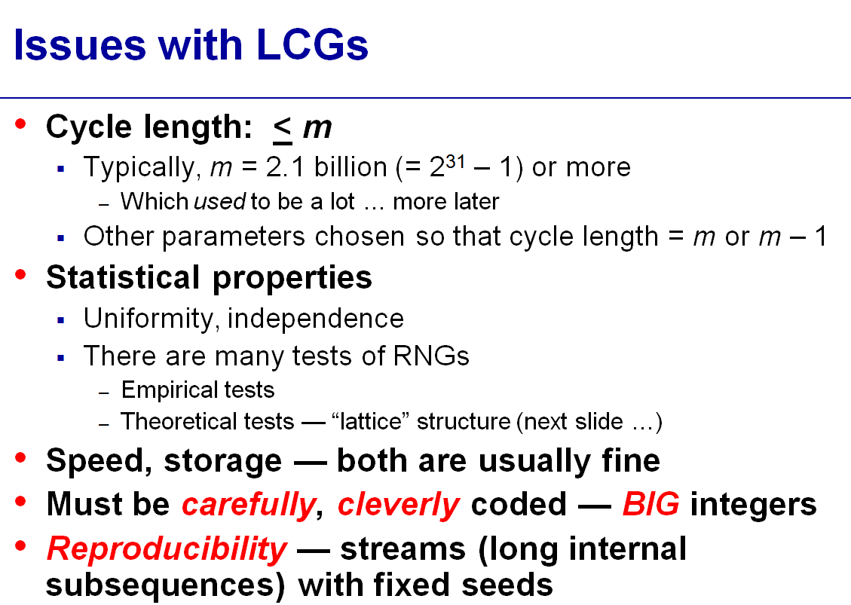

Slide 20
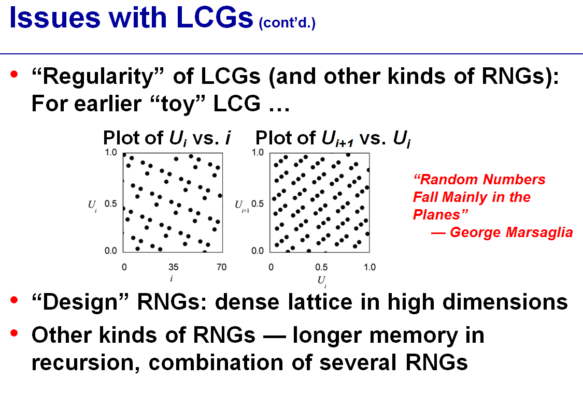

Slide 21
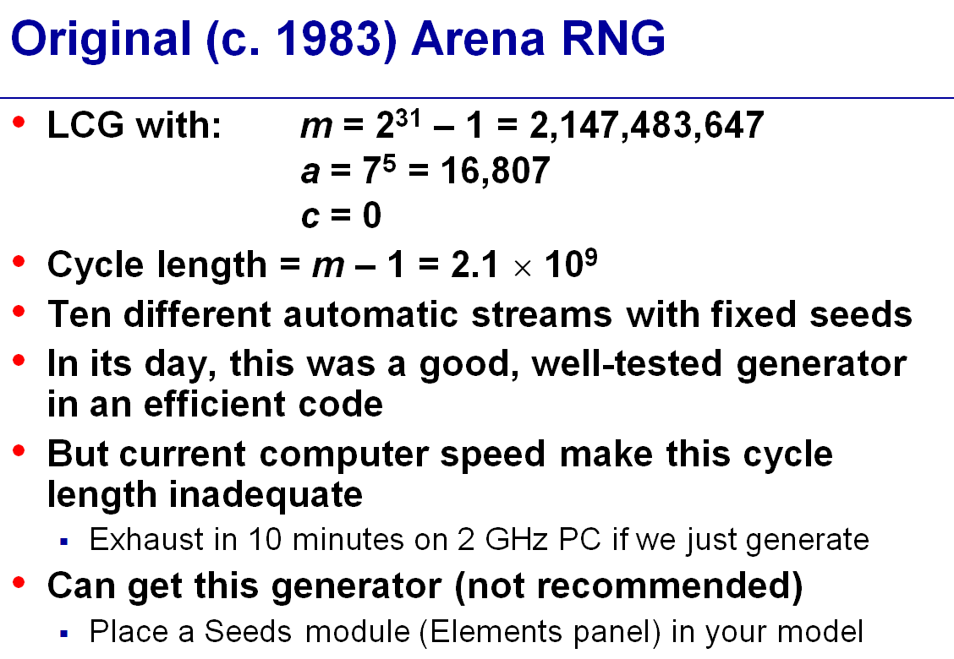

Slide 22
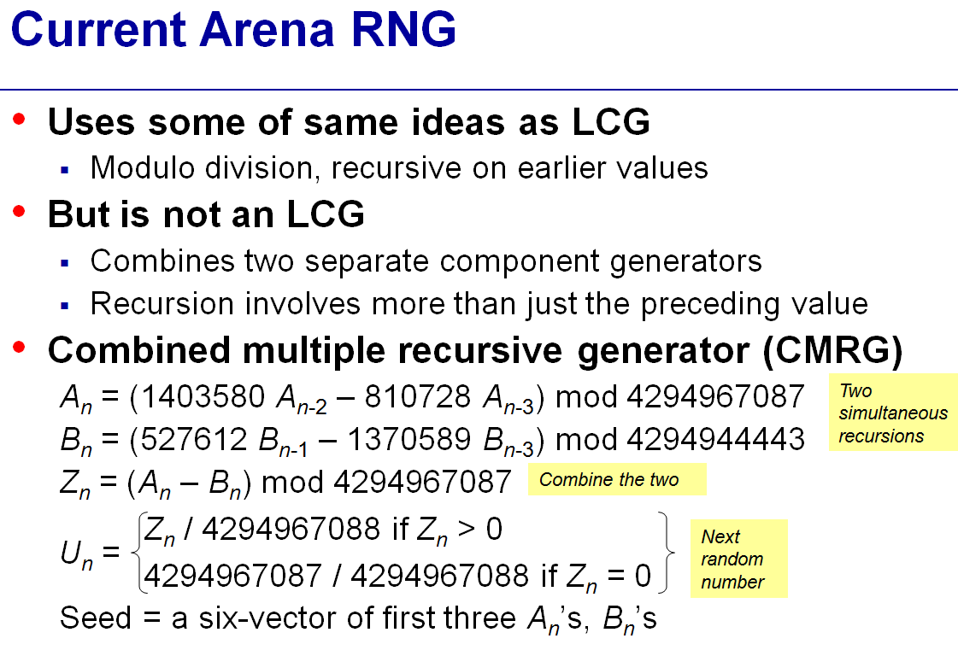

Slide 23
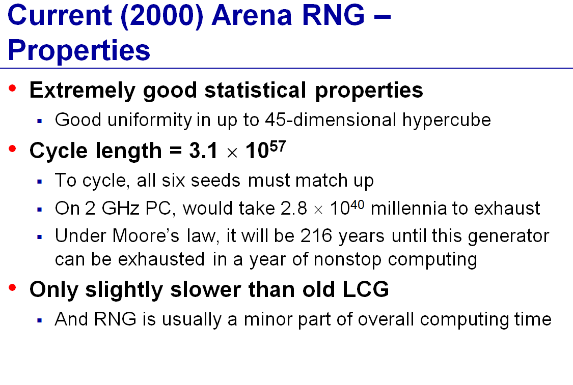

Slide 24
Characteristics of a Good Generator
Maximum Density
Such that he values assumed by R_{i}, i = 1,2,…, leave no large gaps on [0,1]
Problem: Instead of continuous, each R_{i} is discrete
Solution: a very large integer for modulus m
Approximation appears to be of little consequence
Maximum Period
To achieve maximum density and avoid cycling.
Achieve by: proper choice of a, c, m, and X₀.
Most digital computers use a binary representation of numbers
Speed and efficiency are aided by a modulus, m, to be (or close to) a power of 2.

Slide 25
Other Generators
Quadratic Congruential Generator
X_{new} = (a₁ * X_{old}² + a₂ * X_{old} + c) mod m
Combination of generators
Shuffling – shuffle the output from the first LCG with a second LCG
L’Ecuyer – takes integers generated from two different LCGs with different moduli, then
Wichman/Hill – takes the fractional parts of multiple random numbers generated from separate generators
Trausworthe generator
Generates sequence of random bits

Slide 26
Combined Linear Congruential Generators
Example: For 32-bit computers, L’Ecuyer [1988] suggests combining k = 2 generators with m₁ = 2,147,483,563, a₁ = 40,014, m₂ = 2,147,483,399 and a₂ = 20,692. The algorithm becomes:
Step 1: Select seeds
X_{1,0} in the range [1, 2,147,483,562] for the 1st generator
X_{2,0} in the range [1, 2,147,483,398] for the 2nd generator.
Step 2: For each individual generator,
X_{1,j+1} = 40,014 X_{1,j} mod 2,147,483,563
X_{2,j+1} = 40,692 X_{1,j} mod 2,147,483,399.
Step 3: X_{j+1} = (X_{1,j+1} - X_{2,j+1} ) mod 2,147,483,562.
Step 4: Return
Step 5: Set j = j+1, go back to step 2.
Combined generator has period: (m₁ – 1)(m₂ – 1)/2 ~ 2 x 10¹⁸

Slide 27
Tests for Random Numbers
Two categories:
Testing for uniformity:
H₀: R_{i} ~ U[0,1]
H₁: R_{i} ~ U[0,1]
Failure to reject the null hypothesis, H₀, means that evidence of non-uniformity has not been detected.
Testing for independence:
H₀: R_{i} ~ independently
H₁: R_{i} ~ independently
Failure to reject the null hypothesis, H₀, means that evidence of dependence has not been detected.
Level of significance α, the probability of rejecting H₀ when it is true: α = P(reject H₀|H₀ is true)

Slide 28
Frequency Tests
Test of uniformity
Two different methods:
Kolmogorov-Smirnov test
Chi-square test

Slide 29
Kolmogorov-Smirnov Test
Compares the continuous cdf, F(x), of the uniform distribution with the empirical cdf, S_{N}(x), of the N sample observations.
We know:
If the sample from the RN generator is R₁, R₂, …, R_{N}, then the empirical cdf, S_{N}(x) is:
Based on the statistic: D = max| F(x) - S_{N}(x)|
Sampling distribution of D is known (a function of N, tabulated in Table A.8.)
A more powerful test, recommended.

Slide 30
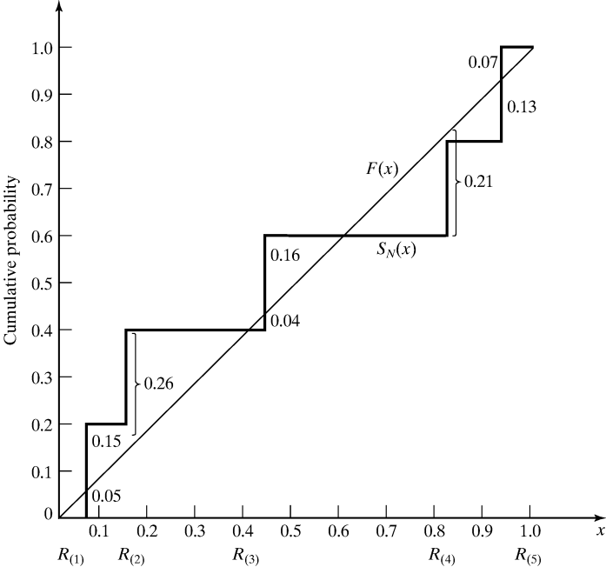
Kolmogorov-Smirnov Test
Example: Suppose 5 generated numbers are 0.44, 0.81, 0.14, 0.05, 0.93.
Arrange R_{(i)} from smallest to largest
Step 1:
R_{(i)} | 0.05 | 0.14 | 0.44 | 0.81 | 0.93
i/N | 0.20 | 0.40 | 0.60 | 0.80 | 1.00
i/N – R_{(i)} | 0.15 | 0.26 | 0.16 | - | 0.07
R_{(i)} – (i-1)/N | 0.05 | - | 0.04 | 0.21 | 0.13
D⁺ = max {i/N – R_{(i)}}
Step 2:
D⁻ = max {R_{(i)} - (i-1)/N}
Step 3: D = max(D⁺, D⁻) = 0.26
Step 4: For α = 0.05,
D_{α} = 0.565 > D
Hence, H₀ is not rejected.
30

Slide 31
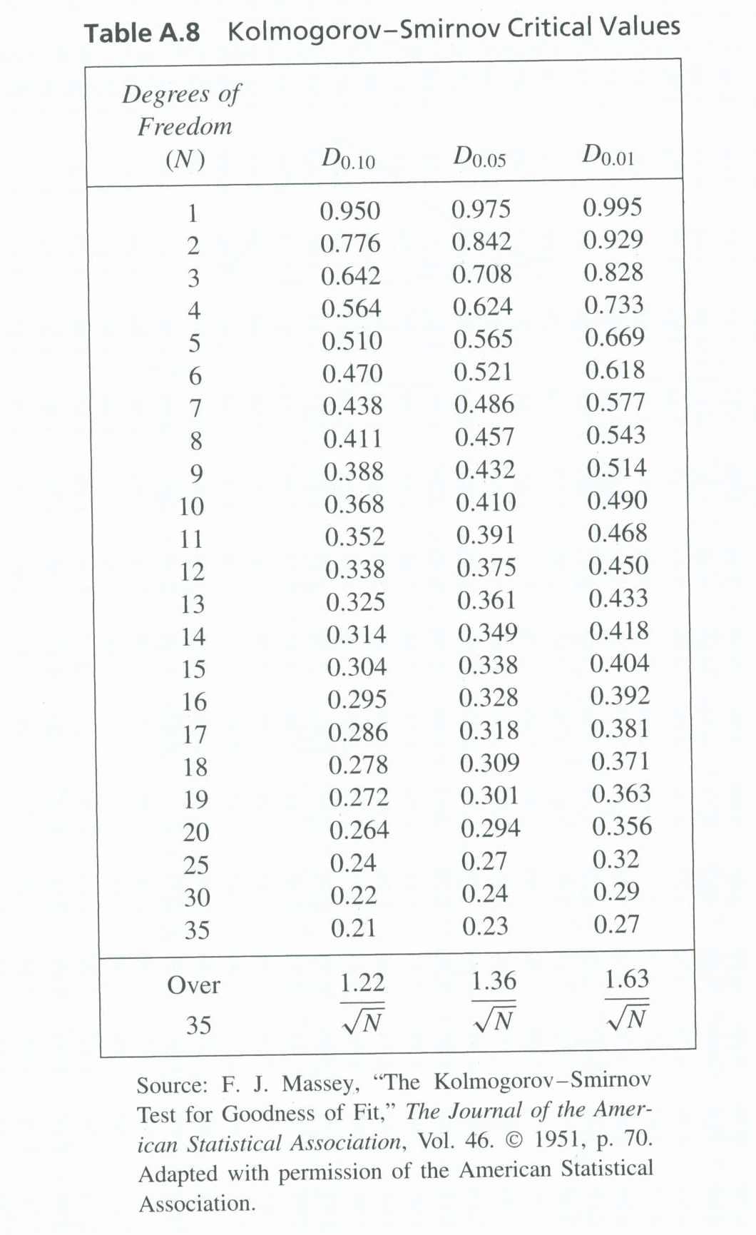

Slide 32
Chi-square test uses the sample statistic:
Approximately the chi-square distribution with n-1 degrees of freedom (where the critical values are tabulated in Table A.6)
For the uniform distribution, E_{i}, the expected number in the each class is:
Valid only for large samples, e.g. N >= 50
n is the # of classes
E_{i} is the expected # in the i^{th} class
O_{i} is the observed # in the i^{th} class

Slide 33
Using R to run KS-test?

Slide 34
Random-Variate Generation
Purpose
Develop understanding of generating samples from a specified distribution as input to a simulation model.
Illustrate some widely-used techniques for generating random variates.
Inverse-transform technique
Acceptance-rejection technique
Special properties

Slide 35
Inverse-transform Technique
The concept:
For cdf function: r = F(x)
Generate r from uniform (0,1)
Find x:
r = F(x)
r₁
x = F⁻¹(r)
x₁

Slide 36
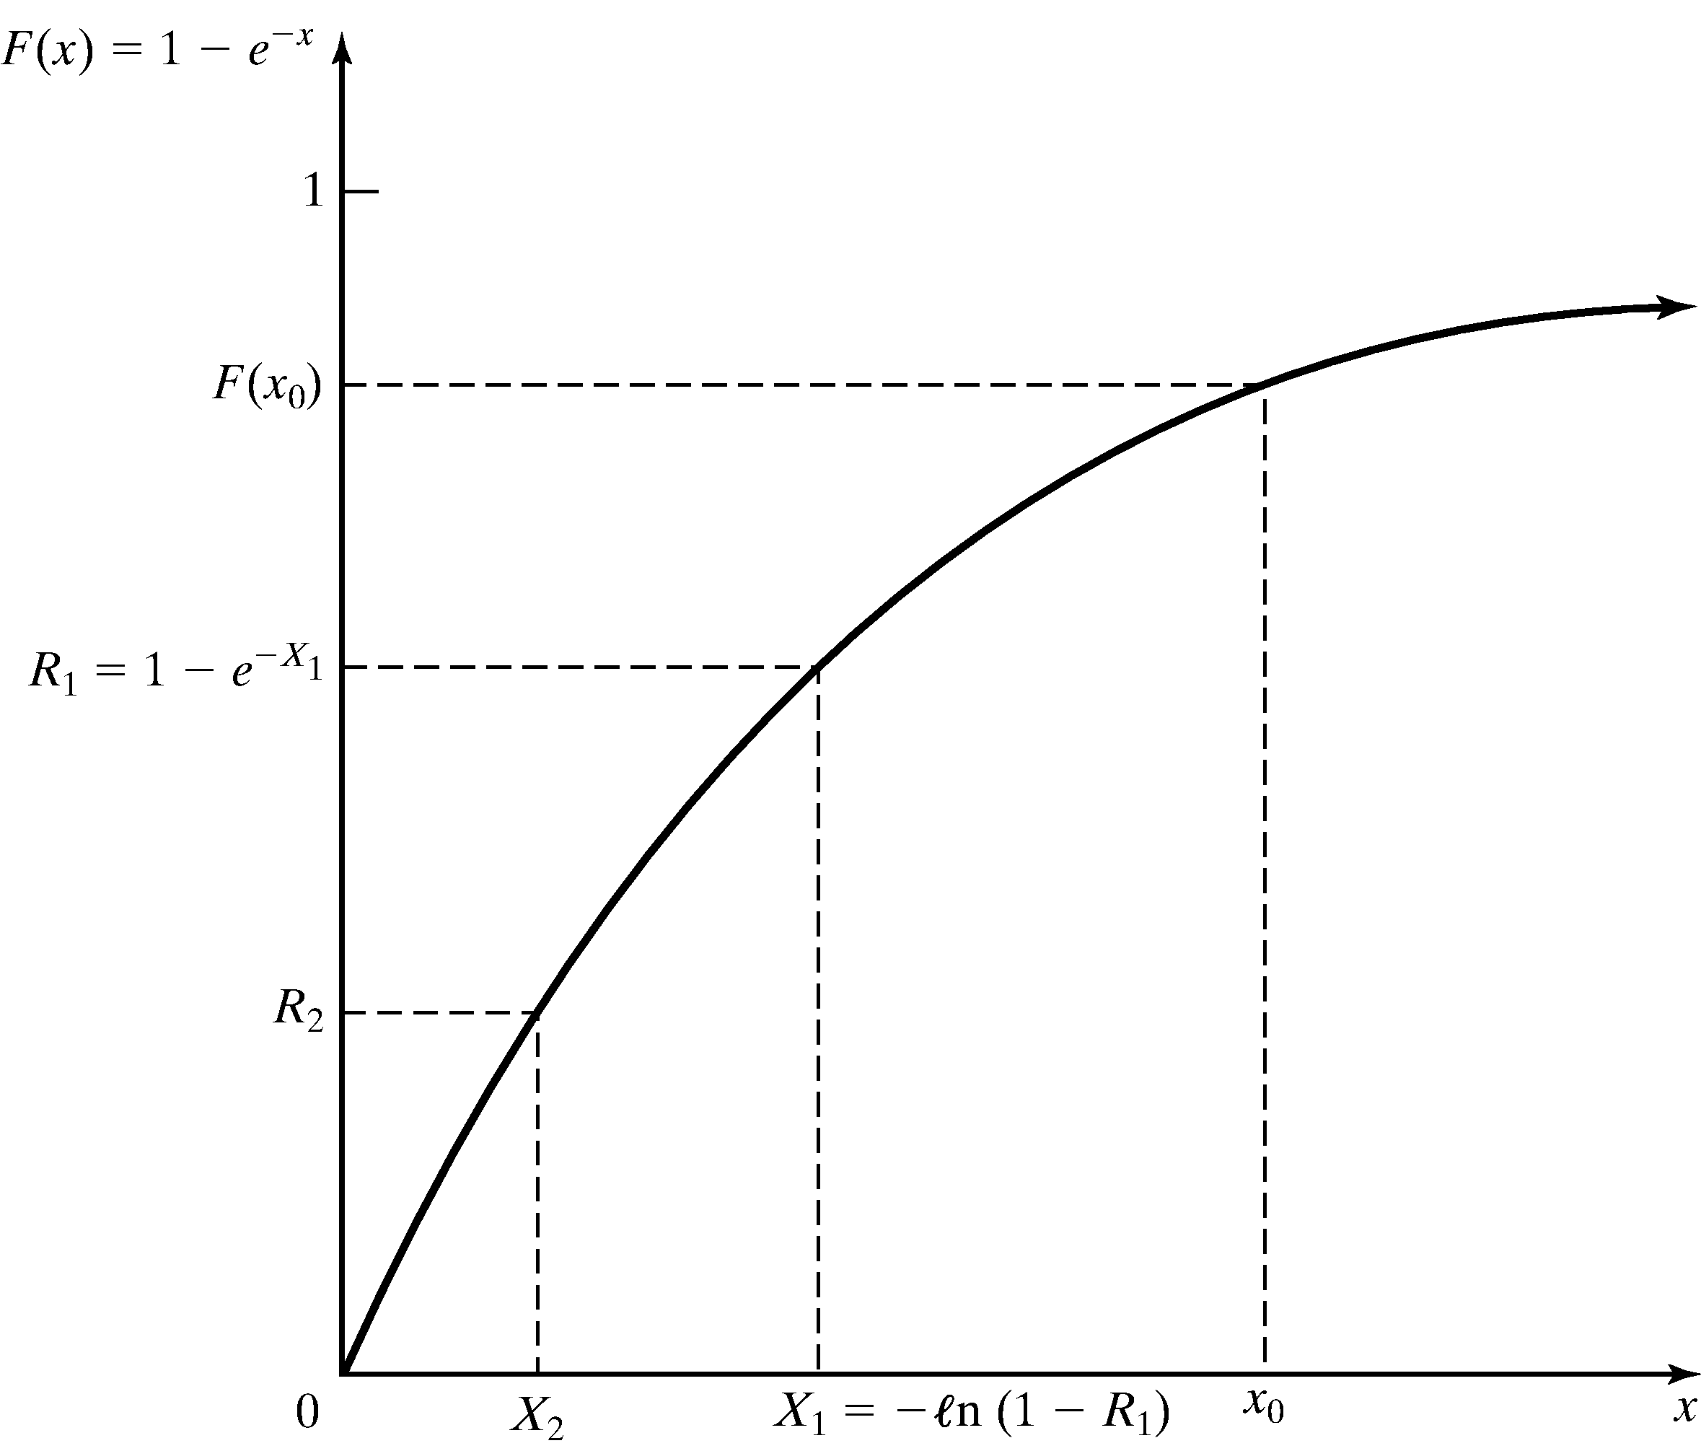
Exponential Distribution
Exponential Distribution:
Exponential cdf:
To generate X₁, X₂, X₃ …
r = F(x)
= 1 – e^{-λx} for x ≥ 0
X_{i} = F⁻¹(R_{i})
= -(1/λ) ln(1-R_{i})
Figure: Inverse-transform technique for exp(λ = 1)

Slide 37
Non-stationary Poisson Process (NSPP)
A Poisson arrival process with an arrival rate that varies with time
Procedures:
Step 1. λ* = max λ(t) = 1/5, t = 0 and i = 1.
Step 2. For random number R = 0.2130,
E = -5ln(0.213) = 13.13
t = 13.13
Step 3. Generate R = 0.8830
λ(13.13)/λ*=(1/15)/(1/5)=1/3
Since R>1/3, do not generate the arrival
Step 2. For random number R = 0.5530,
E = -5ln(0.553) = 2.96
t = 13.13 + 2.96 = 16.09
Step 3. Generate R = 0.0240
λ(16.09)/λ*=(1/15)/(1/5)=1/3
Since R<1/3, T₁ = t = 16.09,
and i = i + 1 = 2

Slide 39
Generate random numbers in R
>runif()

Slide 40
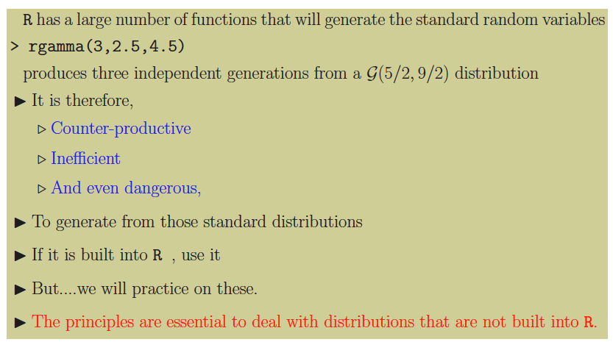
Using the R generators

Slide 41
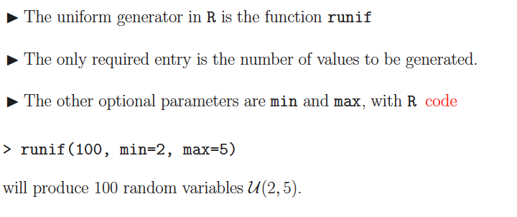
Uniform simulation

Slide 42
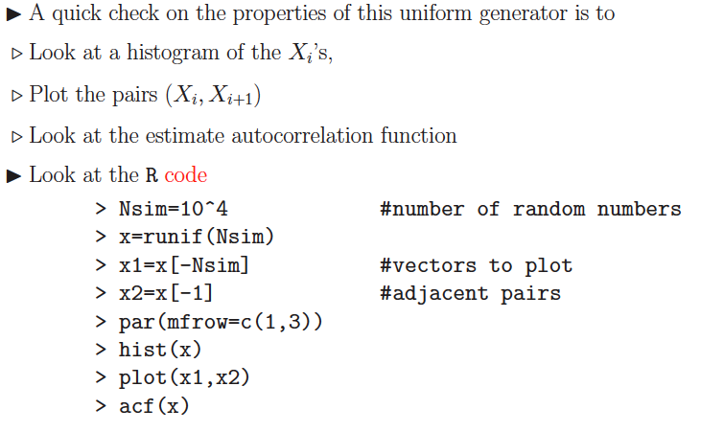
Checking the generator

Slide 43
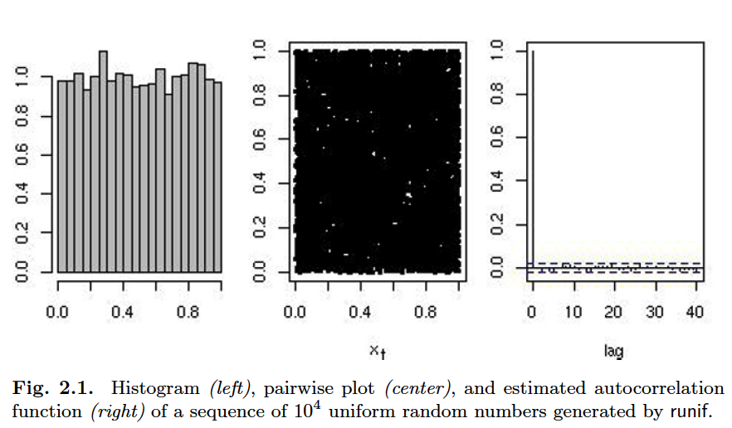
Cont.

Slide 44
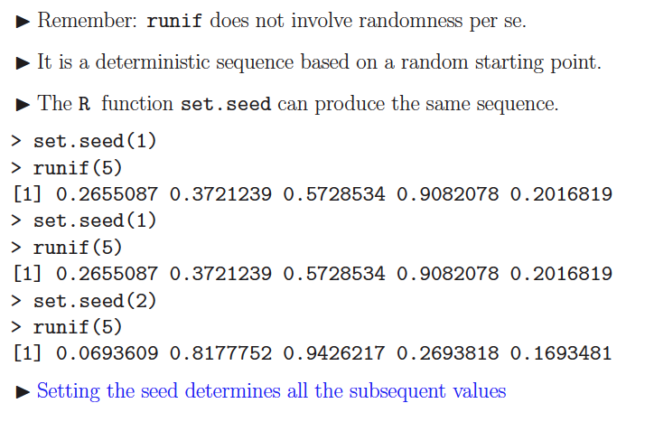
Cont.

Slide 45
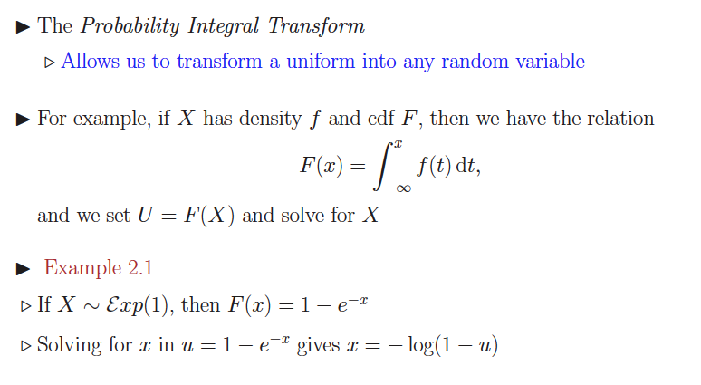
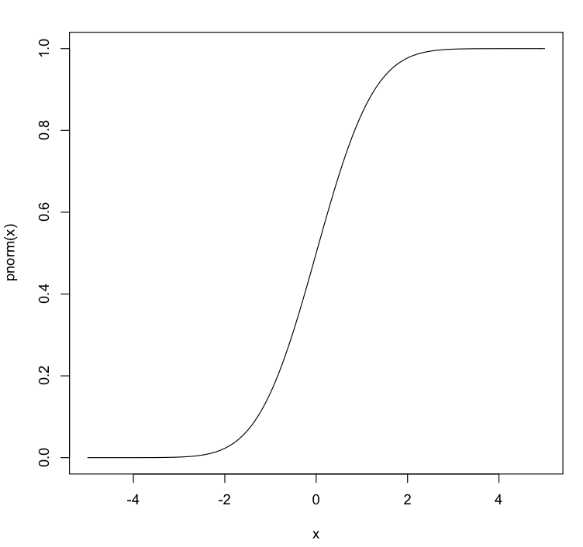
The Inverse Transformation

Slide 46
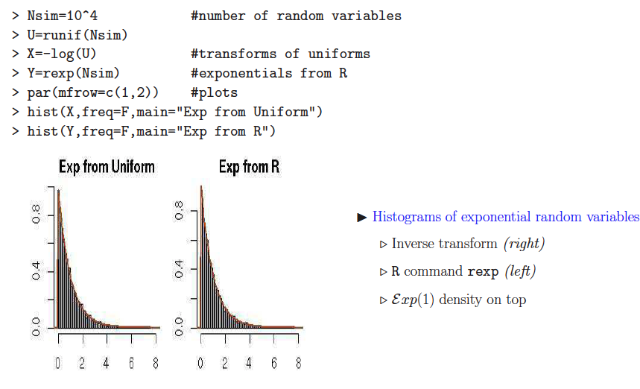
Exponential

Slide 47
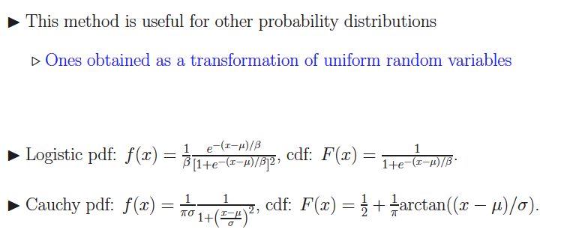
Using uniform

Slide 48
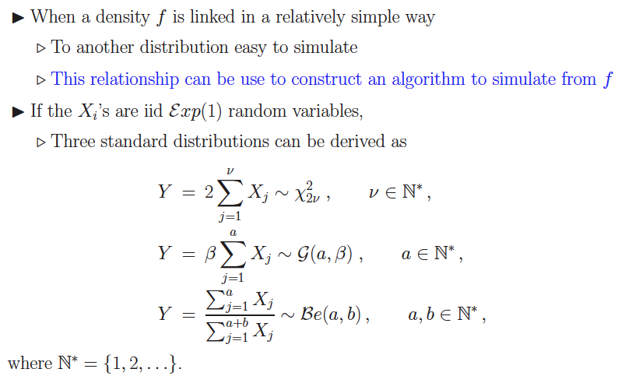
General Transformation Methods

Slide 49
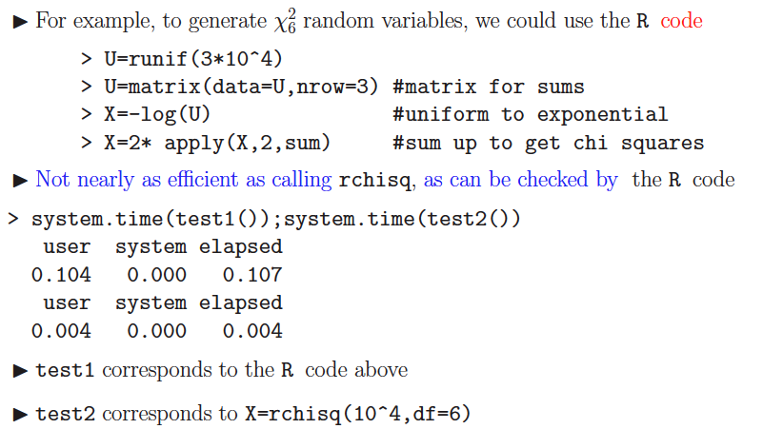
Example

Slide 50
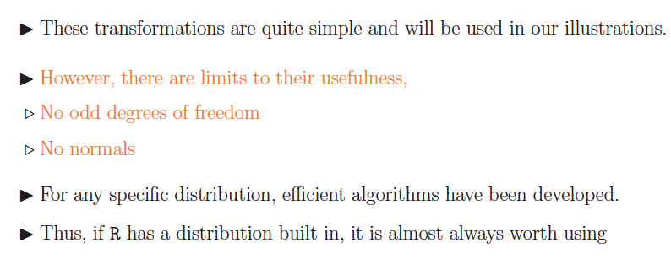
Caveats

Slide 51
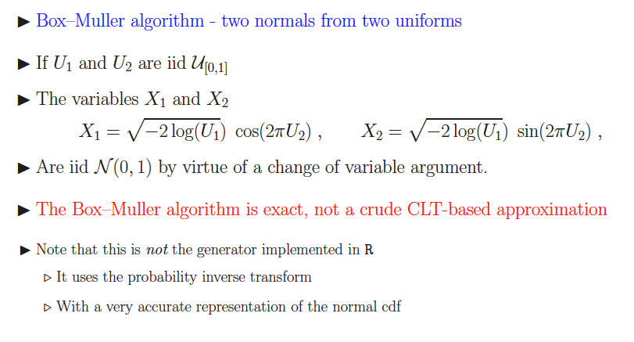
A Normal Generator

Slide 53
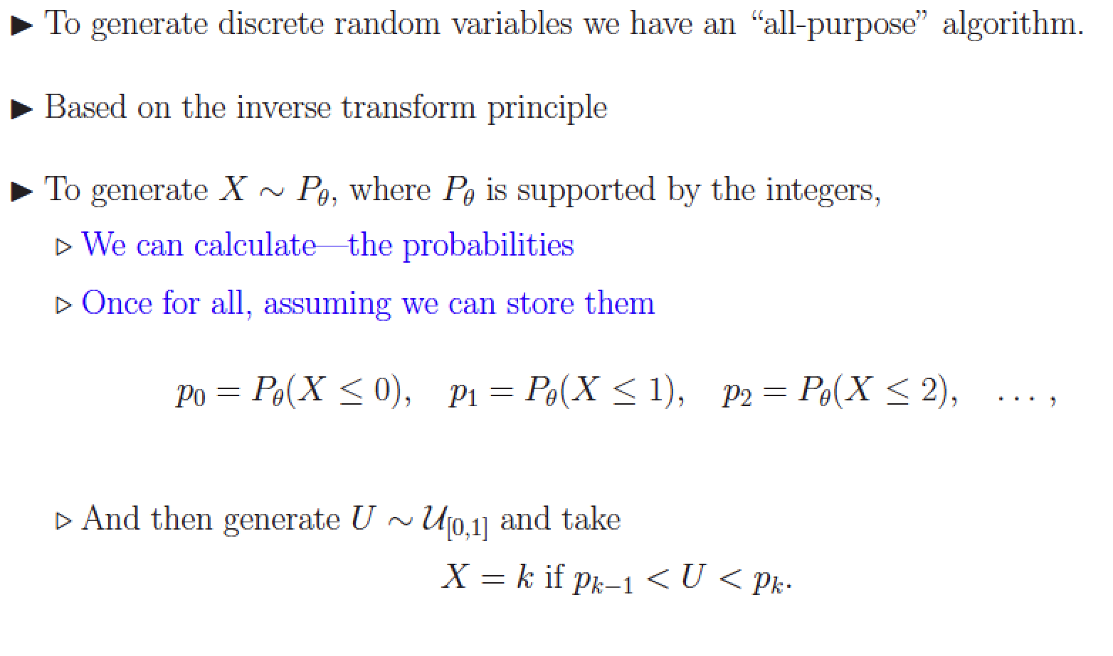
Discrete Distributions

Slide 54
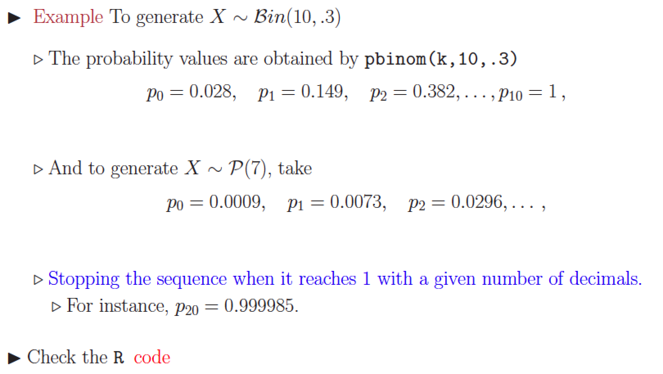
Binomial
Notes:
> ppois(0,7)
[1] 0.000911882
> ppois(1,7)
[1] 0.007295056

Slide 55
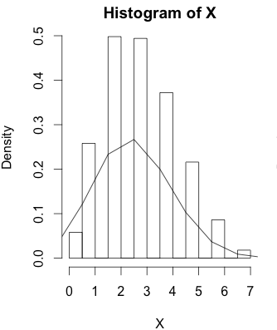
n=10;p=.3;nsim=1000
prob=pbinom(c(0:n),n,p)
X=array(0,dim=c(nsim,1))
for(i in 1:nsim){X[i]=sum(runif(1)>prob)
hist(X,freq=F)
lines(c(0:n)-.5,dbinom(c(0:n),n,p))}

Slide 56
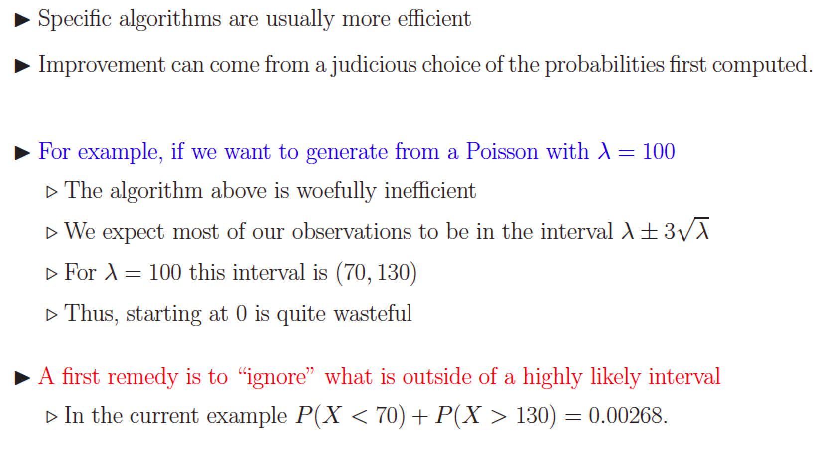
Cont. comments

Slide 57
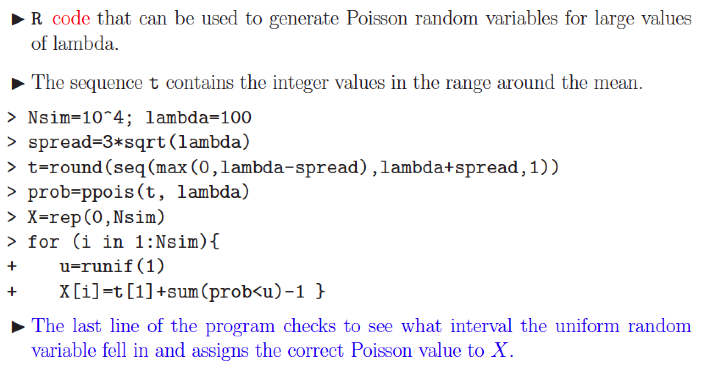
Poisson

Slide 58
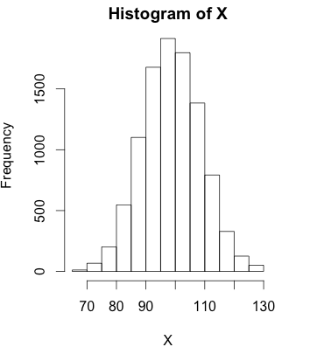
Nsim=10^4; lambda=100
spread=3*sqrt(lambda)
t=round(seq(max(0,lambda-spread),lambda+spread,1))
prob=ppois(t, lambda)
X=rep(0,Nsim)
for (i in 1:Nsim){u=runif(1);X[i]=t[1]+sum(prob<u)-1 }
hist(X)

Slide 59
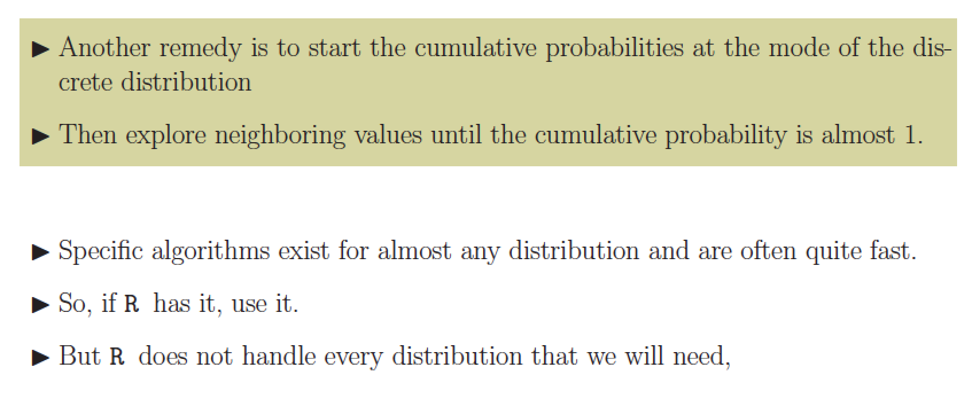
Cont.

Slide 61
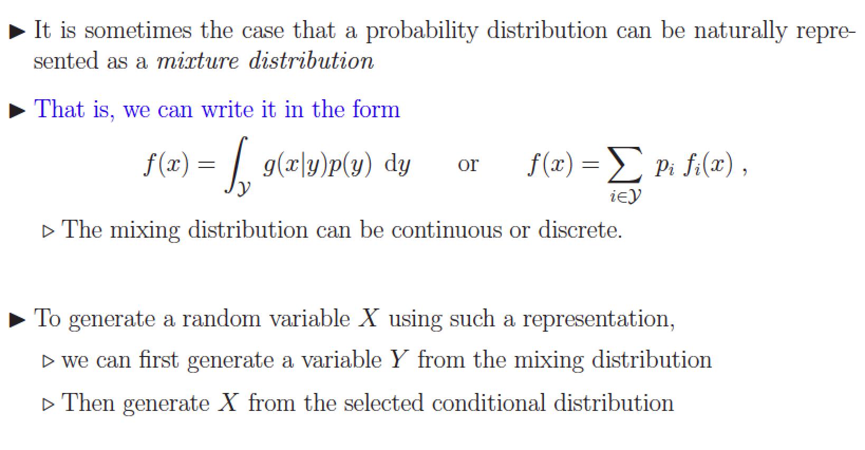
Mixture distribution

Slide 62
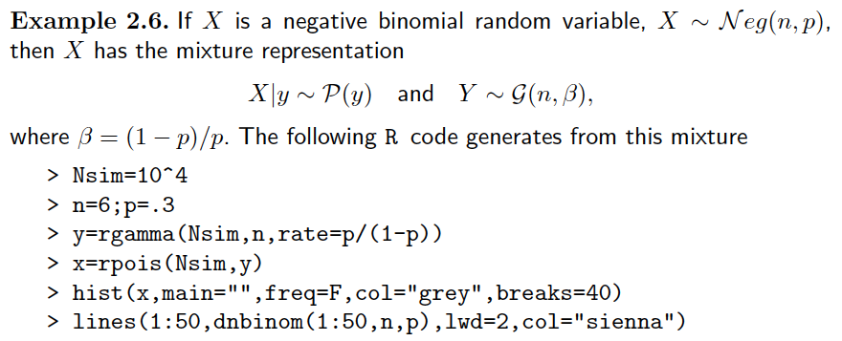
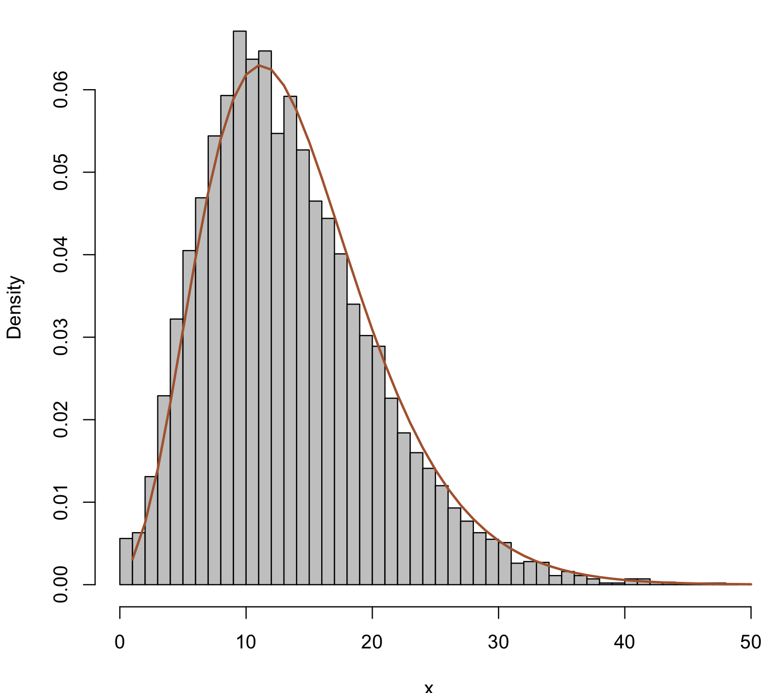
Cont.

Slide 64
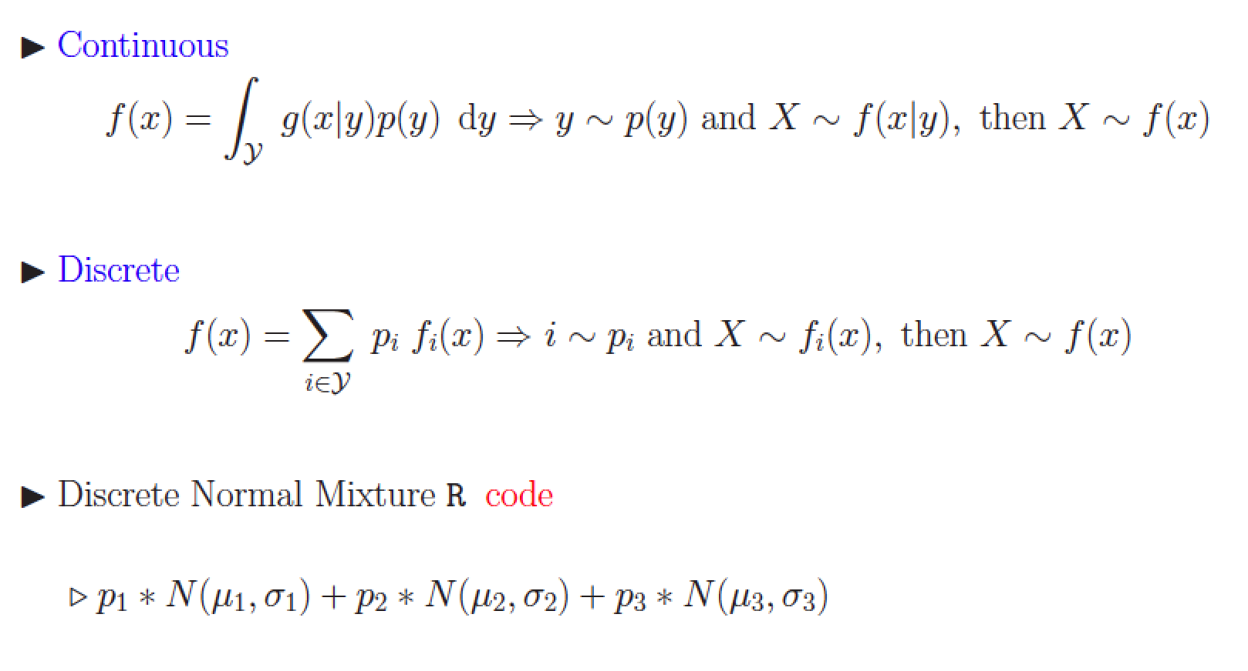
Generating the mixture

Slide 65
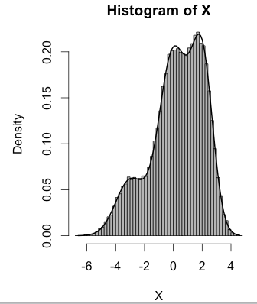
p1<-.15; p2=.5;p3=1-p1-p2;p=c(p1,p2,p3)
m=c(-3,0,2);s=c(1,1,.75)
nsim<-50000;X=array(0,c(nsim,1))
for(i in 1:nsim){j=sum(runif(1)>cumsum(p));X[i]=rnorm(1,mean=m[j+1],sd=s[j+1])}
#This plots histogram and density#
hist(X,freq=F,col="gray",breaks=50)
xplot=seq(min(X),max(X),.1)
Mix=function(x){p[1]*dnorm(x,m[1],s[1])+p[2]*dnorm(x,m[2],s[2])+p[3]*dnorm(x,m[3],s[3])}
lines(xplot,Mix(xplot),lwd=2)

Slide 66
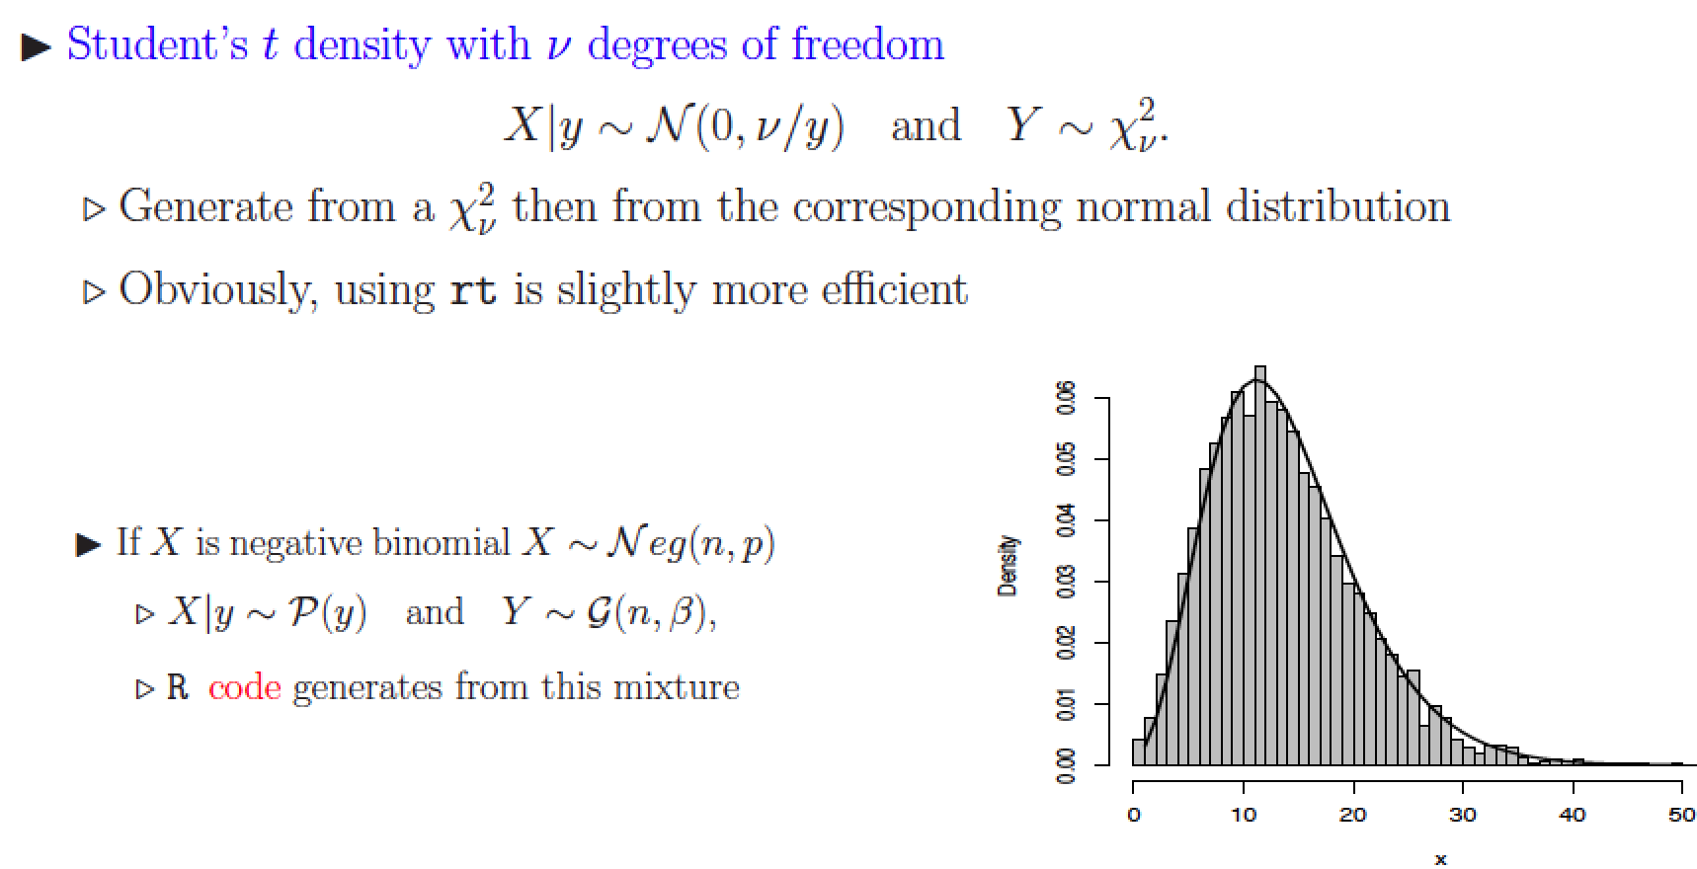
Continuous mixtures

Slide 68
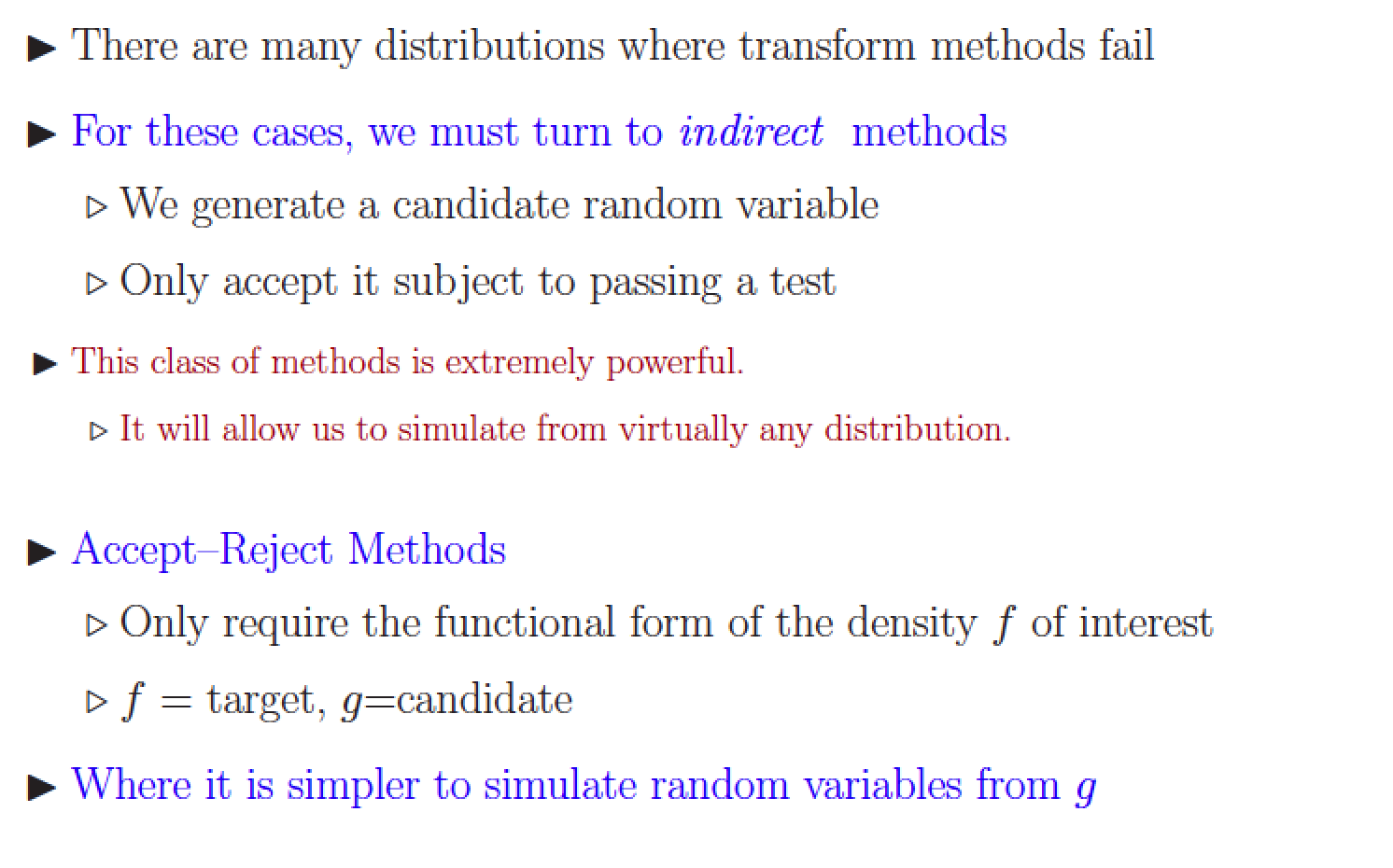
Accept-Reject Methods

Slide 69
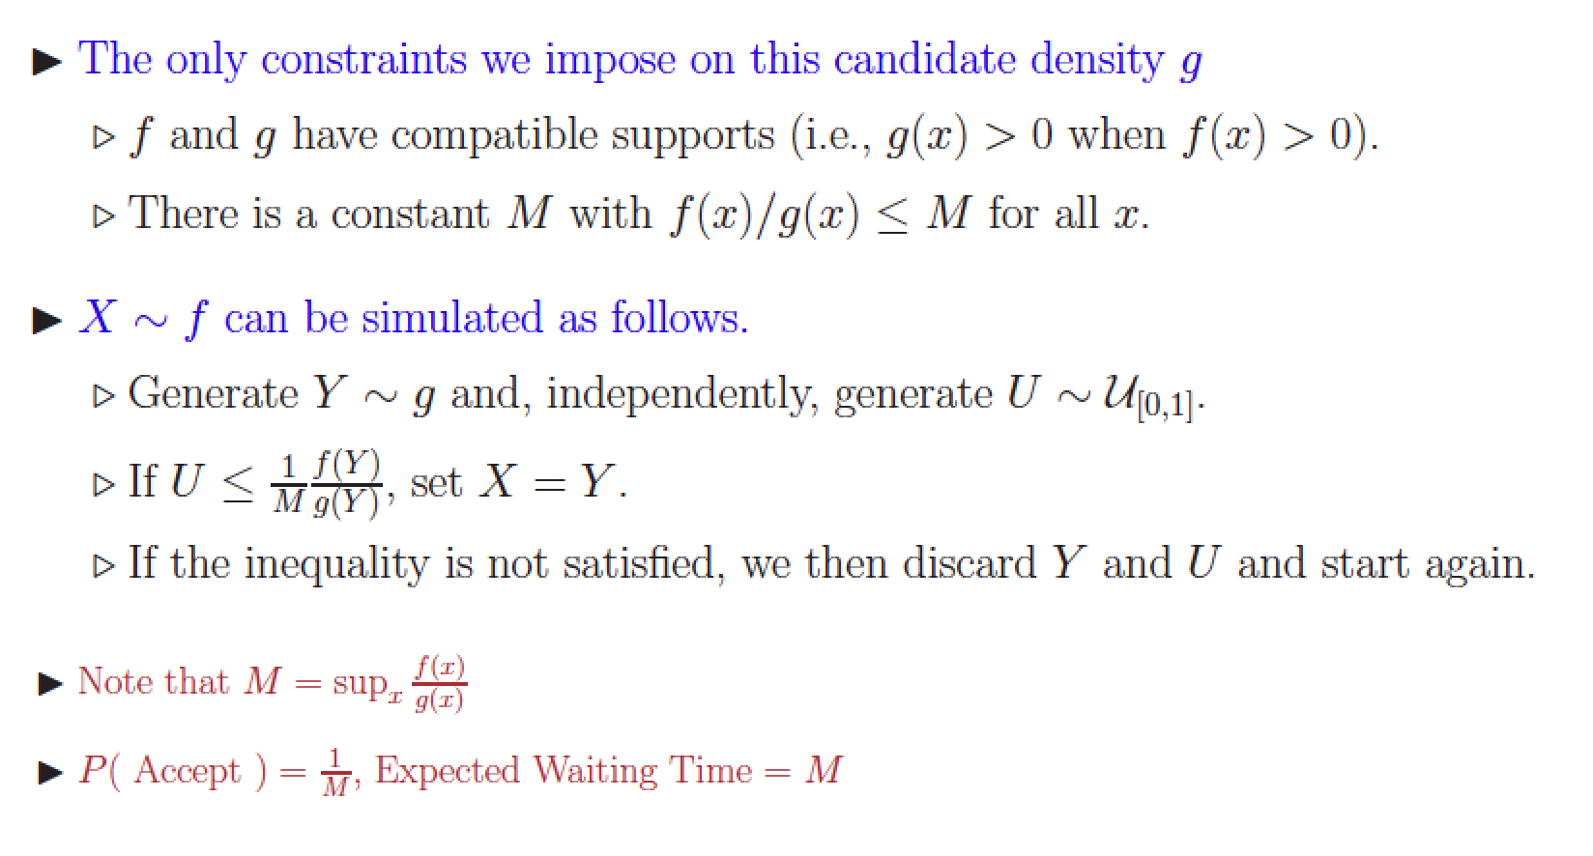
Accept-Reject Algorithm

Slide 70
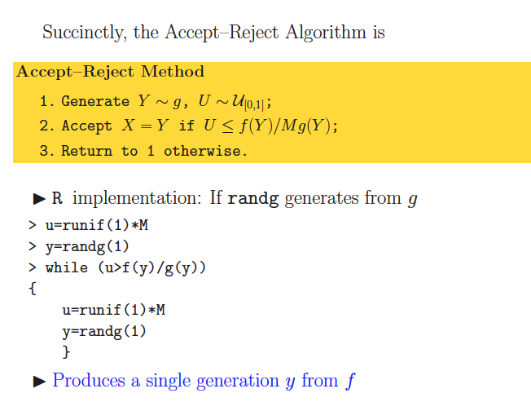
R implementation

Slide 71
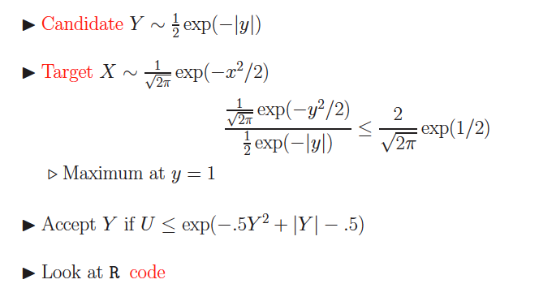
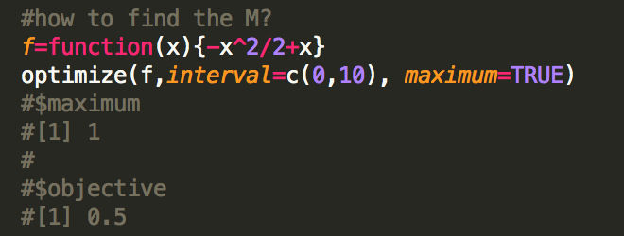
Normal & Double Exponentials
Notes:
f=function(x){-x^2/2+x}
optimize(f,interval=c(0,10), maximum=TRUE)

Slide 72
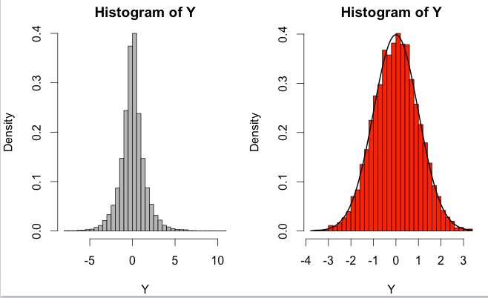
Code
par(mfrow=c(1,2))
nsim=10000
Y=rexp(nsim)
for(i in 1:nsim) if(runif(1)<.5) Y[i]=-Y[i]#random sign
hist(Y,freq=F,col="gray",breaks=50)
for(i in 1:nsim) Y[i]=Y[i]*(runif(1)<exp(-.5*Y[i]^2+abs(Y[i])-.5))
Y<-Y[Y!=0] #eliminate zeros
length(Y)/nsim #percent accepted
hist(Y,freq=F,col="red",breaks=50)
yplot=seq(min(Y),max(Y),.1)
lines(yplot, dnorm(yplot), lwd=2)

Slide 73
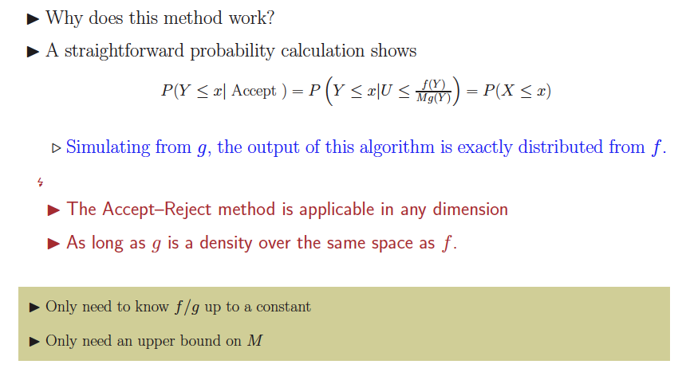
Theory

Slide 74
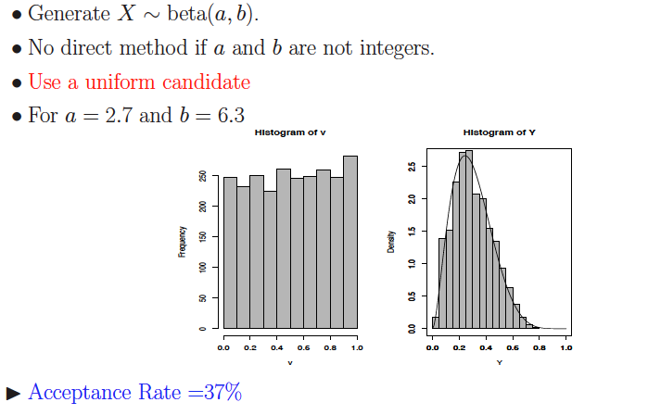
Beta from Uniform

Slide 75
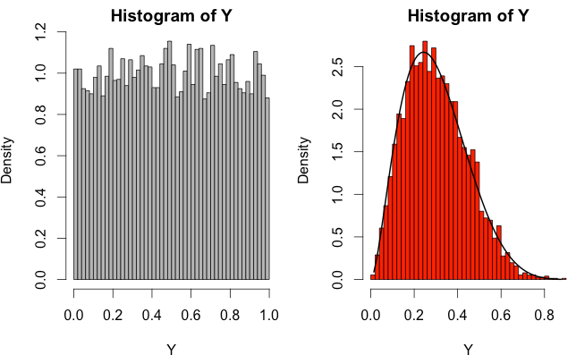
Code
par(mfrow=c(1,2))
nsim<-10000
a<-2.7; b<-6.3; #Target
a1=1; b1=1 #Candidate
temp=(a-a1)/(a-a1+b-b1)
M=(temp^(a-a1))*((1-temp)^(b-b1))
Y=rbeta(nsim,a1,b1)
hist(Y,freq=F,col="gray",breaks=50)
for(i in 1:nsim) Y[i]=Y[i]*(runif(1)<(Y[i]^(a-a1))*((1-Y[i])^(b-b1))/M)
Y<-Y[Y!=0] #eliminate zeros
length(Y)/nsim #percent accepted
hist(Y,freq=F,col="red",breaks=50)
yplot=seq(min(Y),max(Y),.01)
lines(yplot, dbeta(yplot,a,b), lwd=2)

Slide 76
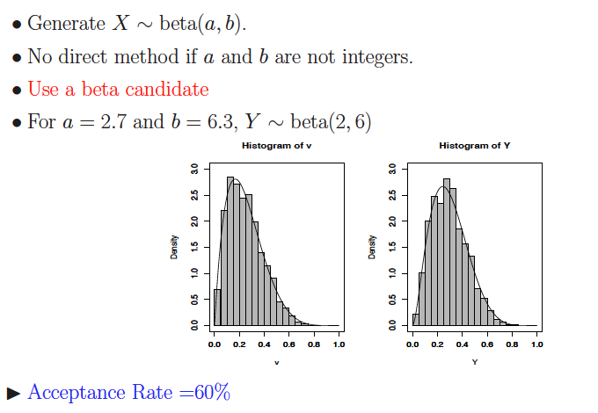
Beta from Beta

Slide 77
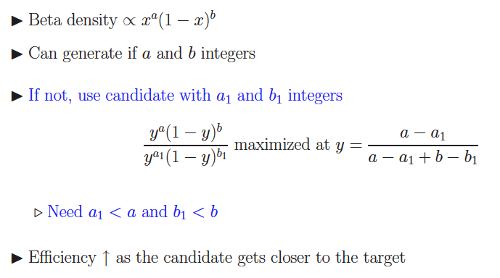

Slide 78
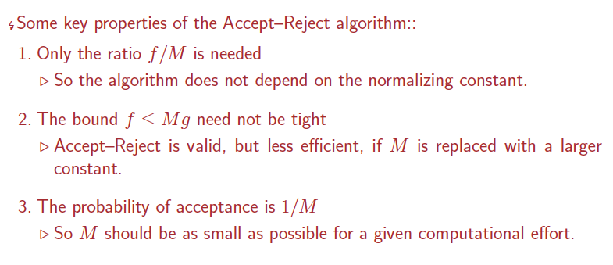
Comments

Slide 79
R code
RNG.R

Slide 80
What’s next?
MCMC
A tour of AnyLogic

Slide 81
Acknowledgement
Wikipedia.Org
Christian P. Robert & George Casella, “Introducing Monte Carlo Methods with R”. Springer, 2009.

